Slide 1

Government Engineering College Raipur
Major Project
Disease Prediction Using
Fast Text Generation
Project Guide – Mr. Pushpendra Dhar Dwivedi
Team Members
Rupali Baghel (301602220001)
Akanksha Bansod (301602220014)
Adarsh Singh Pawar (301602219004)

Slide 2
Objective
Efficient disease detection through text generation stands as our primary objective.
In addition to identifying the detected disease, the user is provided with precautionary measures to ensure their safety.

Slide 3
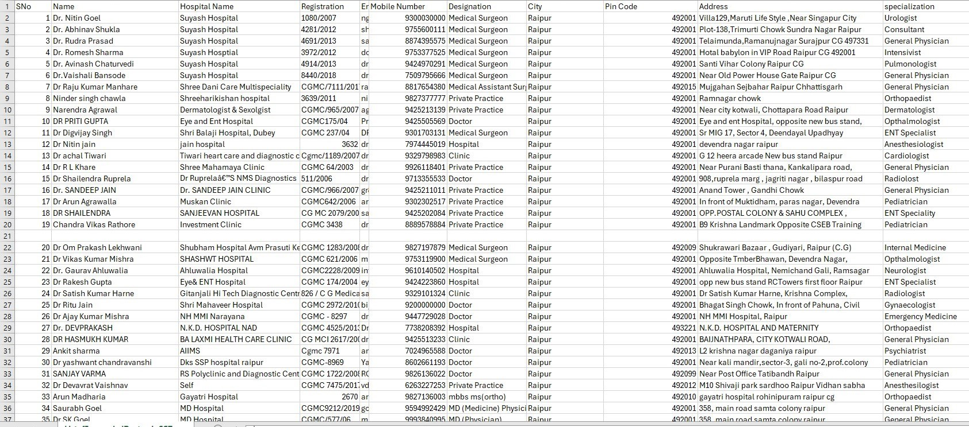
New Data Set

Slide 4
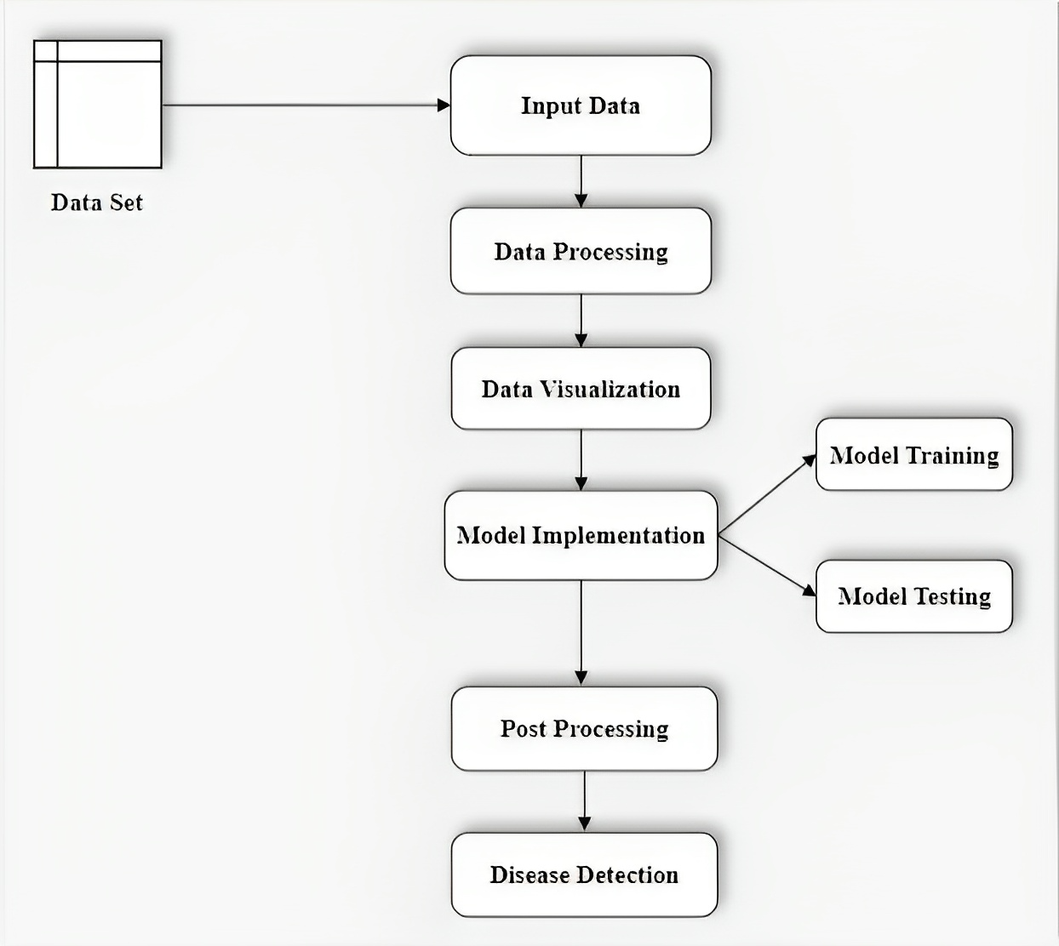
Methodology

Slide 5


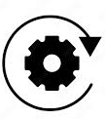



Flowchart
USER
INPUT SYMPTOMS
PROCESSING
DATA
DATABASE
MODEL
OUTPUT

Slide 6
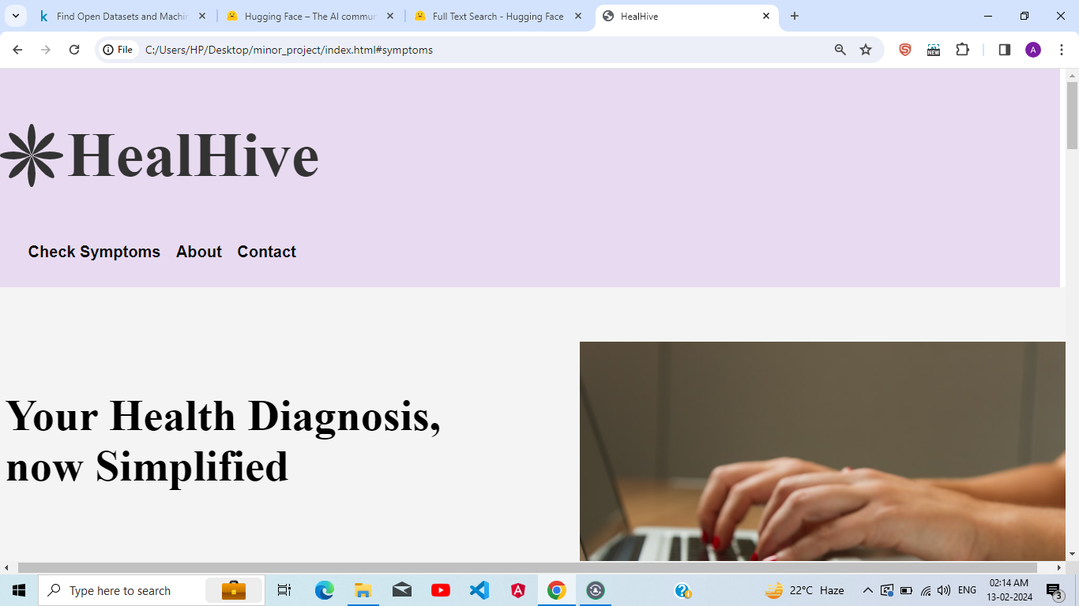
Website

Slide 7
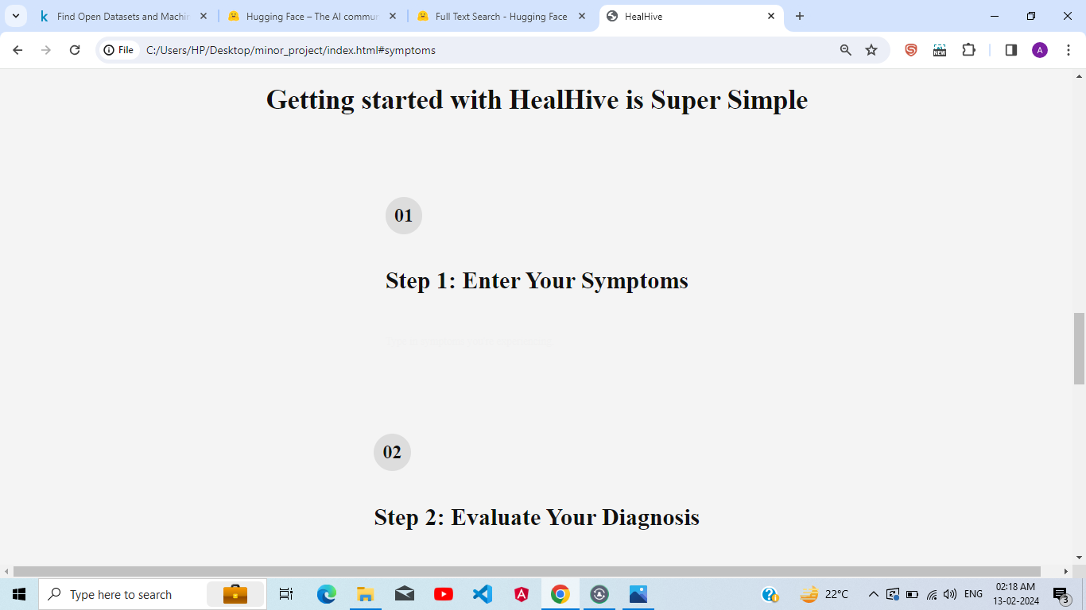

Slide 8
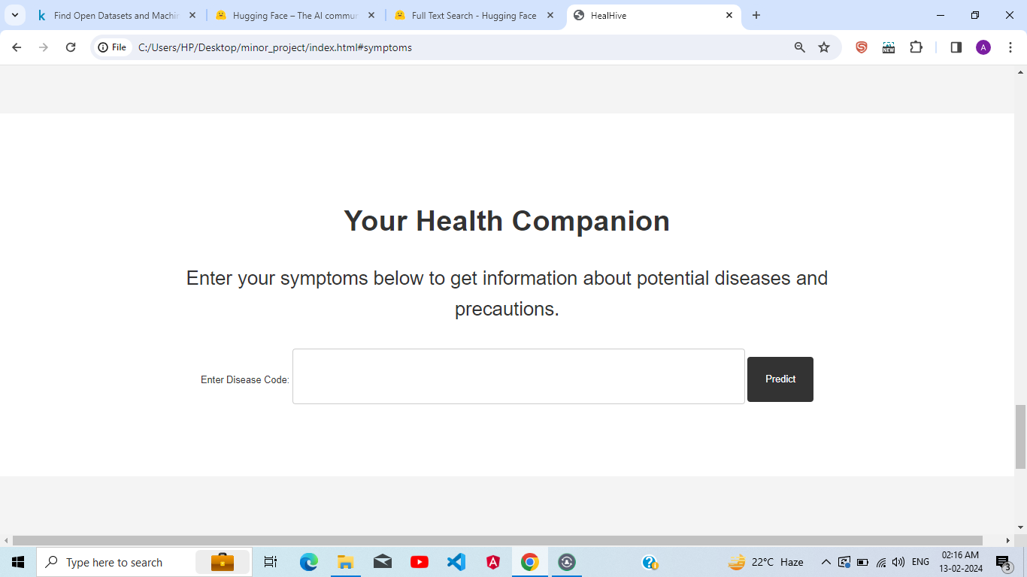

Slide 9
Accuracy
S.No. | Model | Accuracy
01 | LSTM | 80%
02 | PARALLEL | 78%
03 | GRU | 85%
04 | REGRESSION | 71%

Slide 10
Thank You

